Slide 1

FITNESS TRACKER
Carlos • Chad • Kabir • Neil
Notes:
Hey everyone! We are the fitness guys, and we are excited to finally be able to present our work to everyone. Without Further adieu, let's get started.

Slide 2
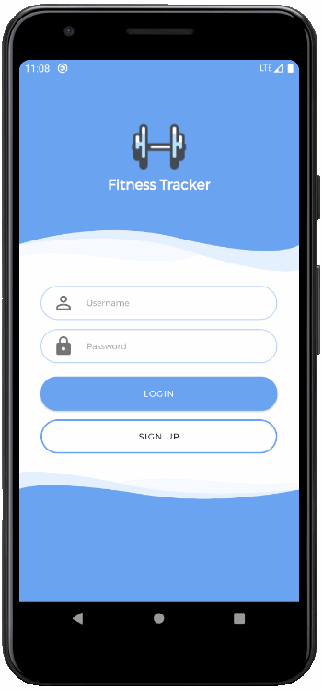

Overview of Fitness Tracker
User profile creation and fitness tracking
Designed for various fitness levels and goals
Easy to use and navigate
Tracking includes workout duration and calories burnt
Access to a wide variety of training videos
Notes:
Our app allows for users to create online profiles to track their fitness goals. This is a self reporting fitness app with simplicity in mind.
It will allow for the user to input their workouts and track their activity. Once the users workout is complete, they will be presented with a summary report that consists of their workouts, time, and how much calories they’ve burned
Users will also have access to training videos which are categorized with a wide range of different workout techniques so even new users could get started.
Finally, users are presented with a home screen which displays the date, weather, quick daily summary, and previous workouts

Slide 3
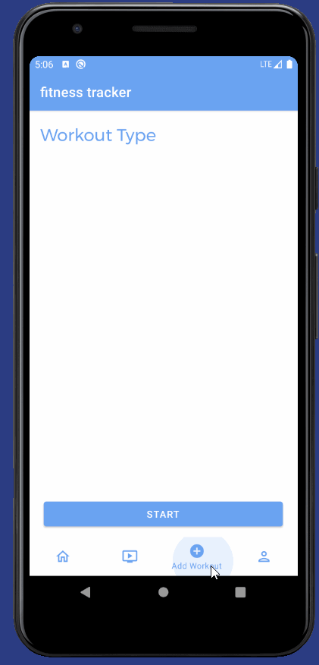
Tracking
Main goal of our app
Allows users to input their workouts
One of the main goals of the Fitness
Can track more than one workout at a time
Selected workout type helps calculate calories burnt in summary
screen
Notes:
One of the main Goals of the Fitness Tracker is let the user input their desired workouts. It also allows for the user to track more than one workout at a time! Their selected workouts will also help in the calculation of the calories burned in the summary screen

Slide 4
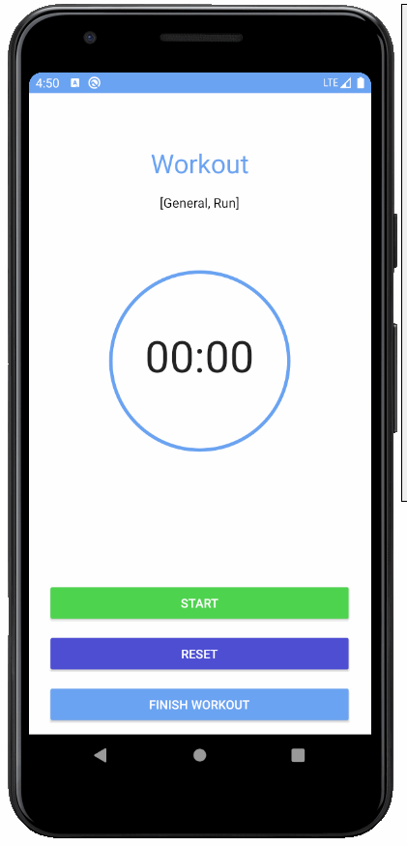
Timer
Once the user selects their desired workouts, they are presented with a timer to track their workout.
The user is provided with basic functionality which consists of: Start/Stop button, Reset, and Finish workout which will redirect them to the summary screen

Slide 5
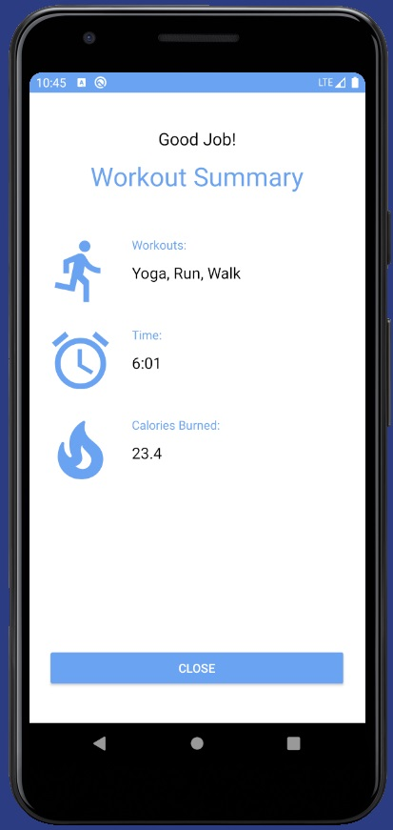
Summary Screen
Presented to user once workout is completed
Displays workout type, time, calculated calories burnt
Scientific formula used to calculate to provide an estimate of calories burnt
Workout data is stored in the backend
Notes:
Once the workout is complete, the user is presented with their workout summary. It displays the users workouts, time, and their calculated calories that they’ve burned. We used a scientific formula to provide the user with an estimation of how much calories they’ve burned. The workout data is then stored in the backend for future analysis, or review

Slide 6
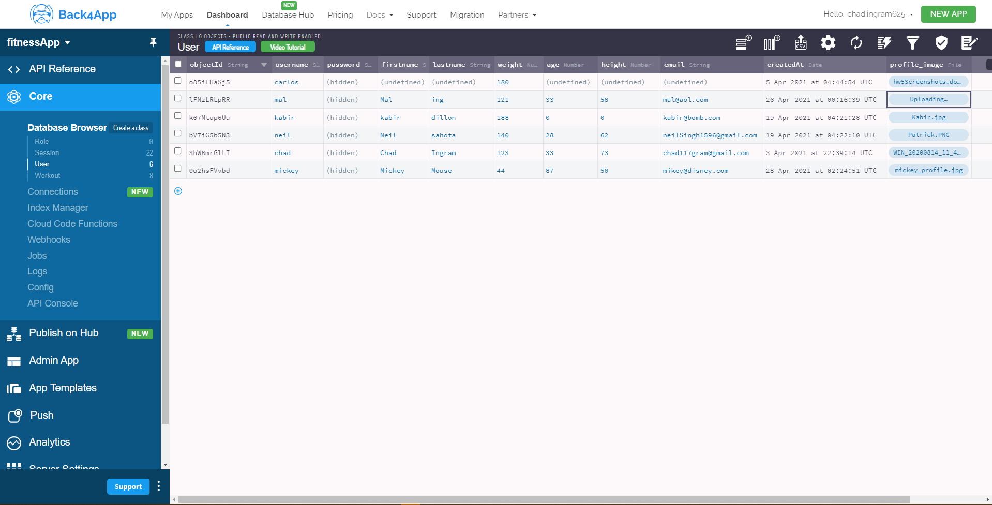
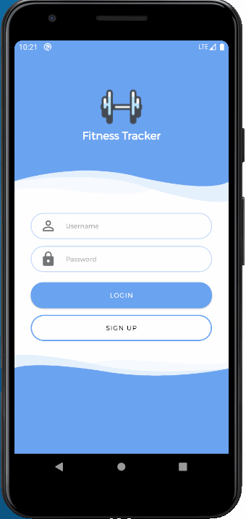
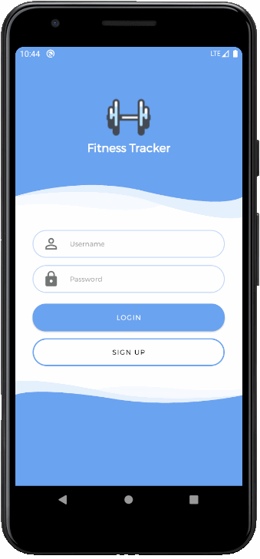
Login and Sign up
Goals:
To create a seamless user Login and Sign up experience.
To manage user’s personal data via Parse in the Back4app.

Slide 7
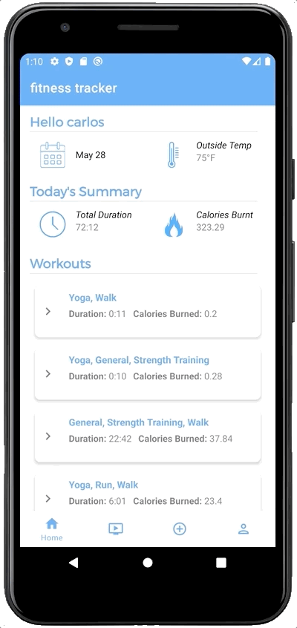
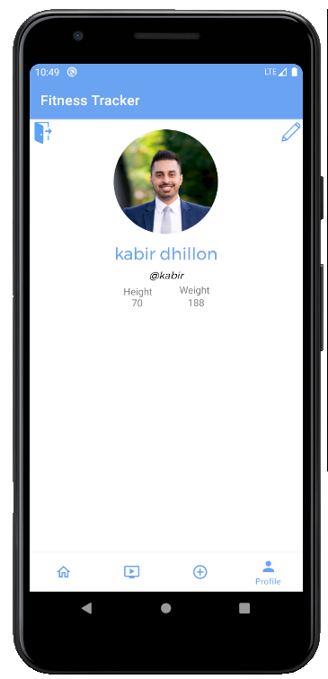
Home & Profile
Home
General summary
Date & temperature
Total workout time
Calories Burnt
Lists today’s workouts
Profile
Includes user information
Option to logout and edit user information

Slide 8
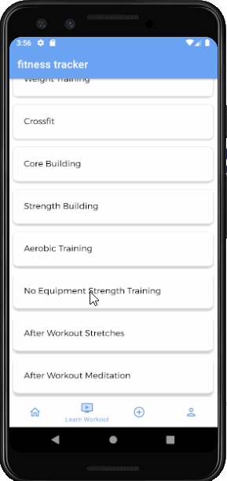
Training Videos
Users can select workout categories, and then select a type of workout
Follow along videos- watch workout videos during their workout
Workouts videos include stretching and non-equipment workouts
Made for all fitness levels
Notes:
Workout training page, allows a user to select a workout category from a list of categories. Once the user selects a type of workout, user will receive a list of workout videos that can be used to learn from or follow along with a workout routine. Includes pre and post workout stretching, as well as, no equipment workout categories for anyone to follow along. New users can learn new exercises and returning users can follow along on a preset routine.

Slide 9
THANKS
Carlos Vera-Rosas
linkedin.com/in/carlos-vera-rosas-0b0126183/
ANY QUESTIONS?
Kabir Dhillon
linkedin.com/in/kabirdhillon/
Chad Ingram
linkedin.com/in/chad-ingram/
Neil
linkedin.com/in/suritaneil-sahota-716277169/
GitHub Link:
github.com/Fitness-Guys/Fitness-App

